Slide 1

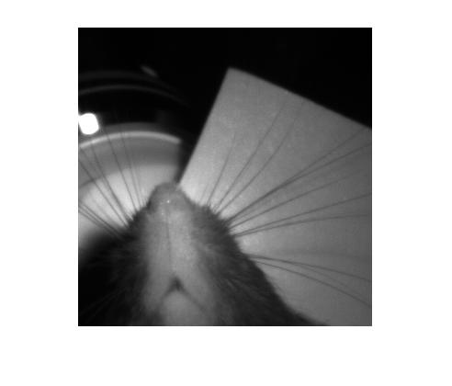
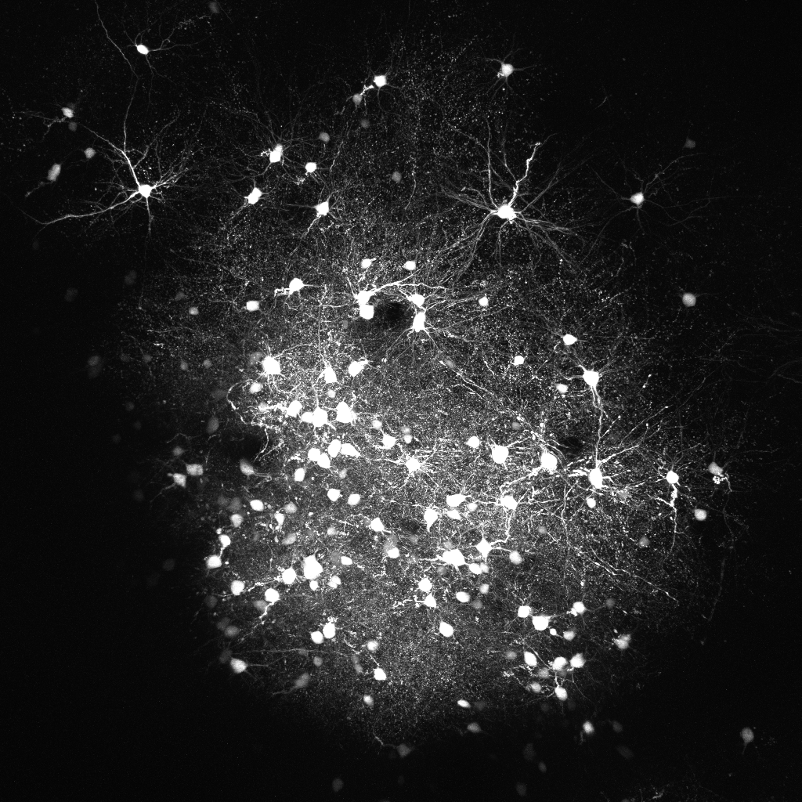
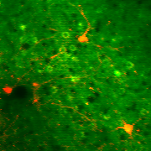
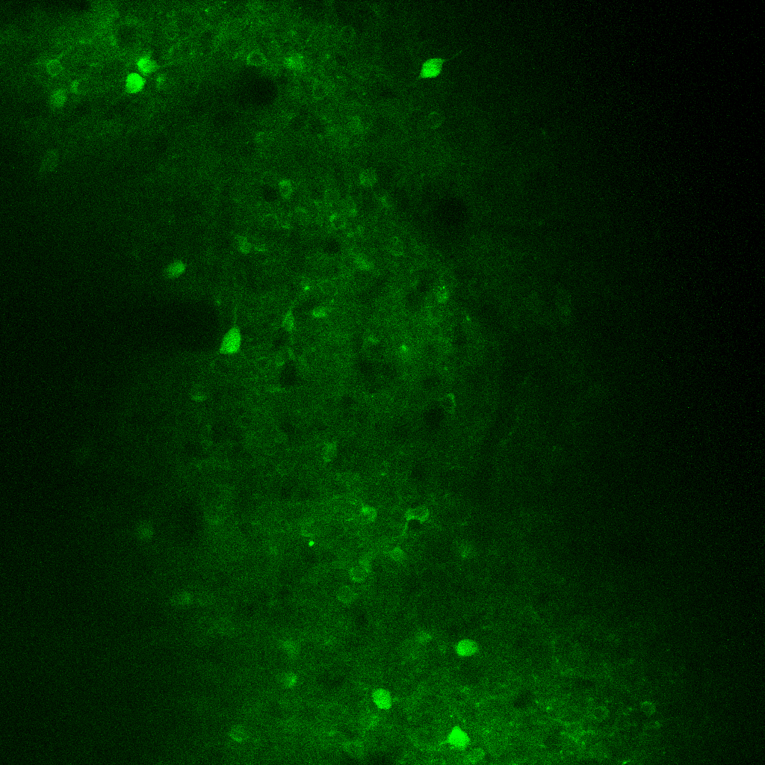
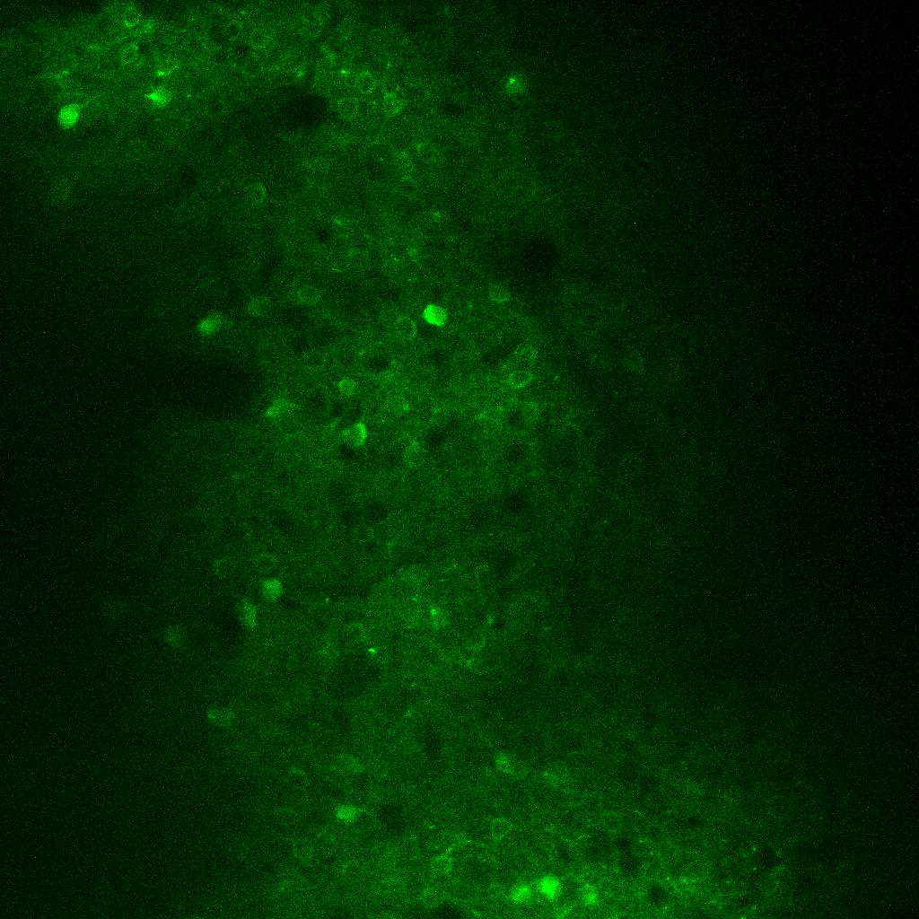
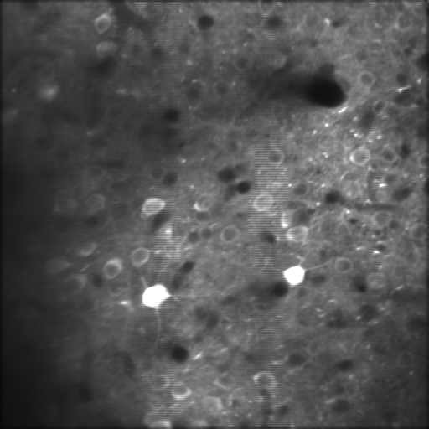
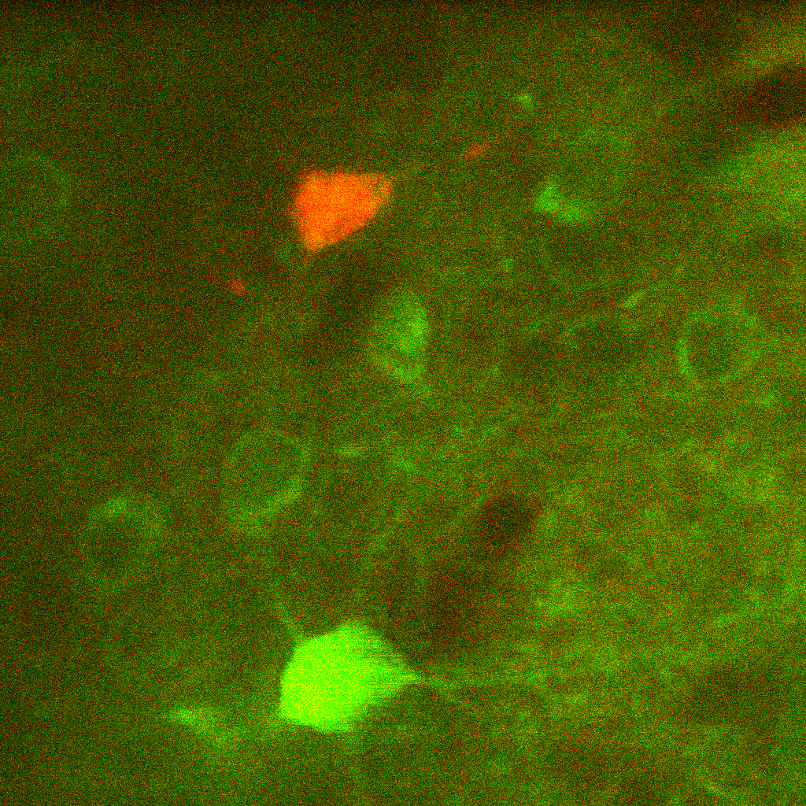
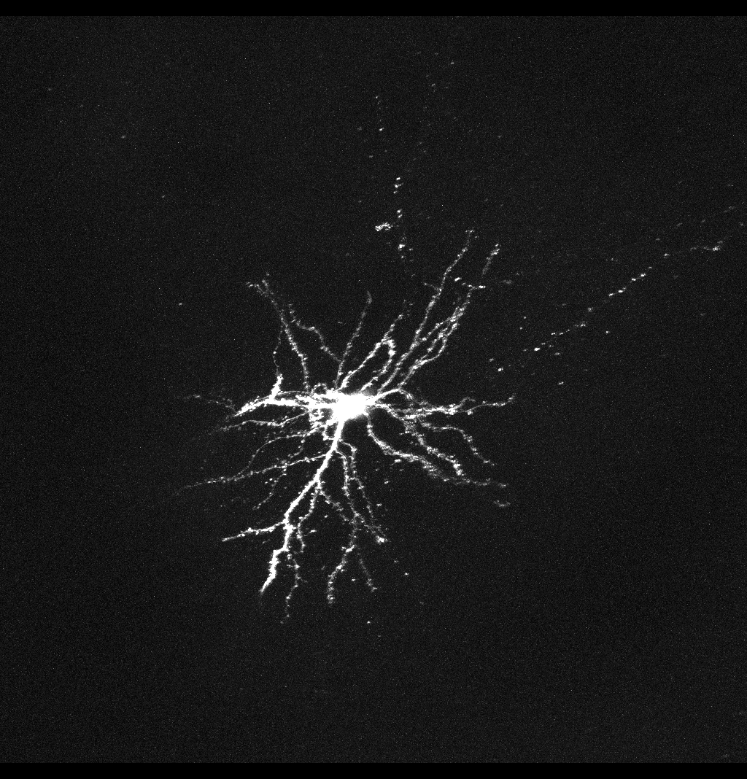
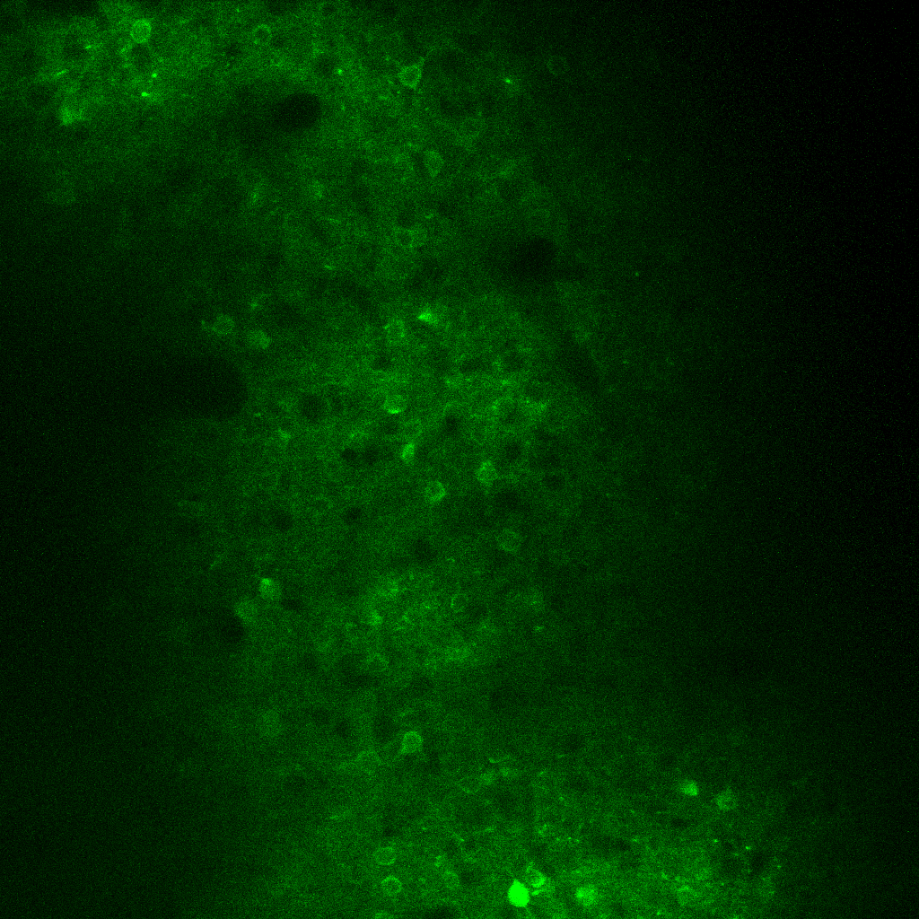
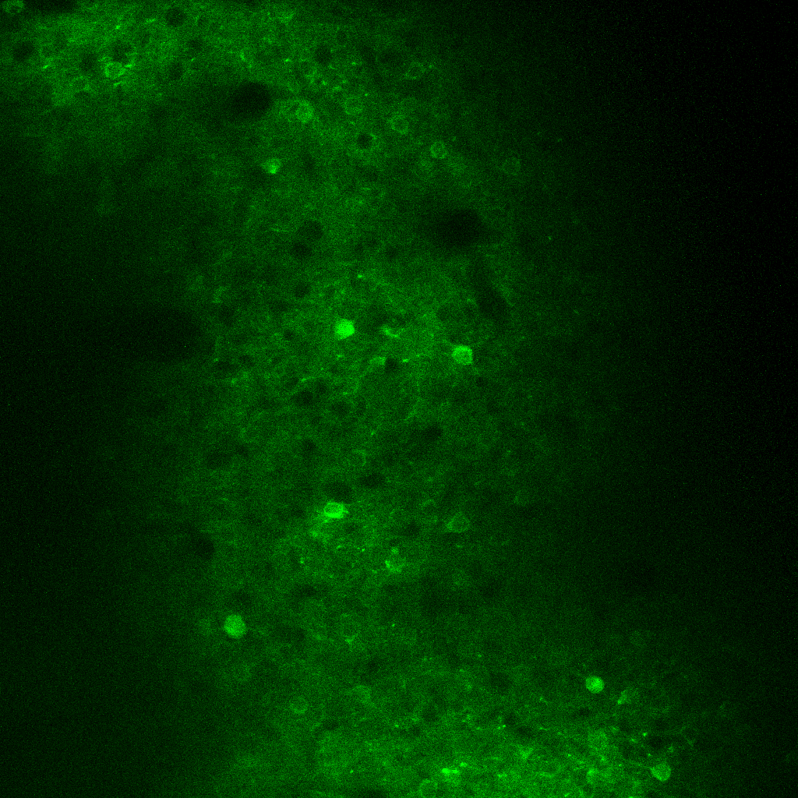
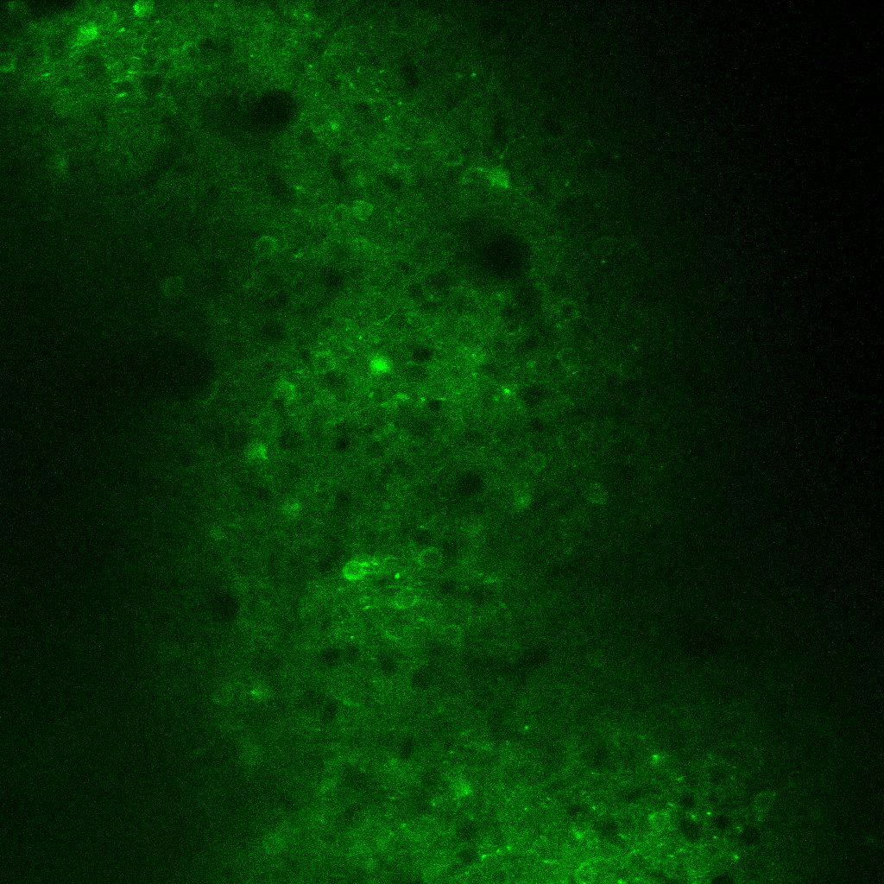
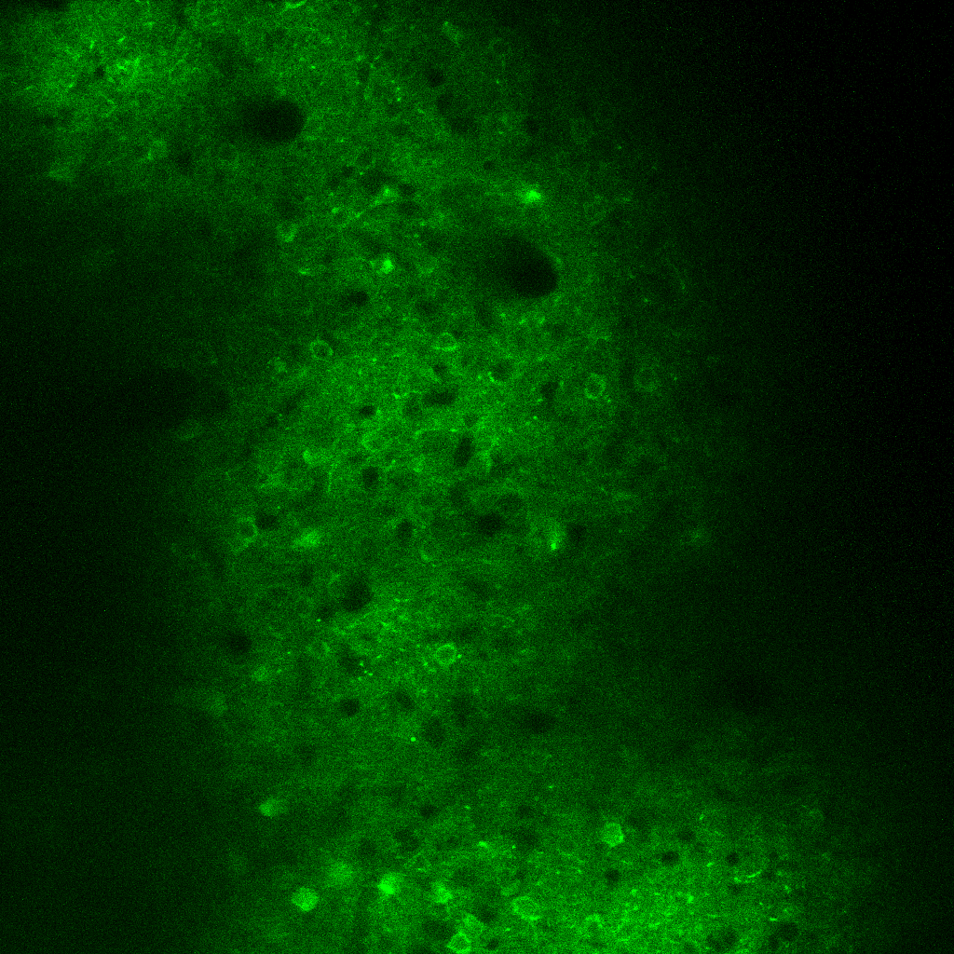
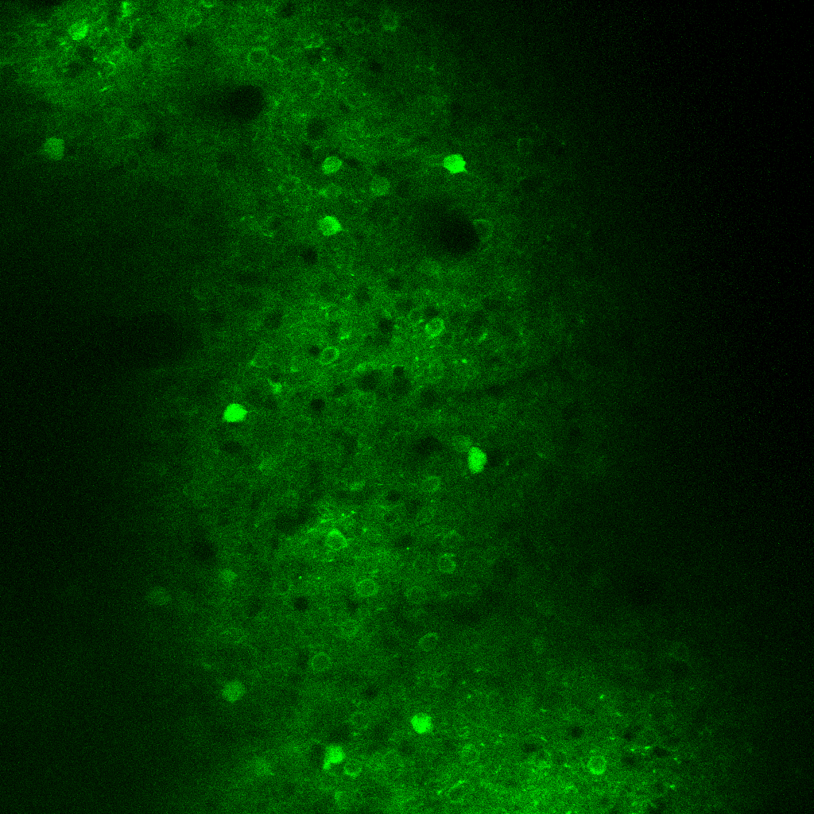

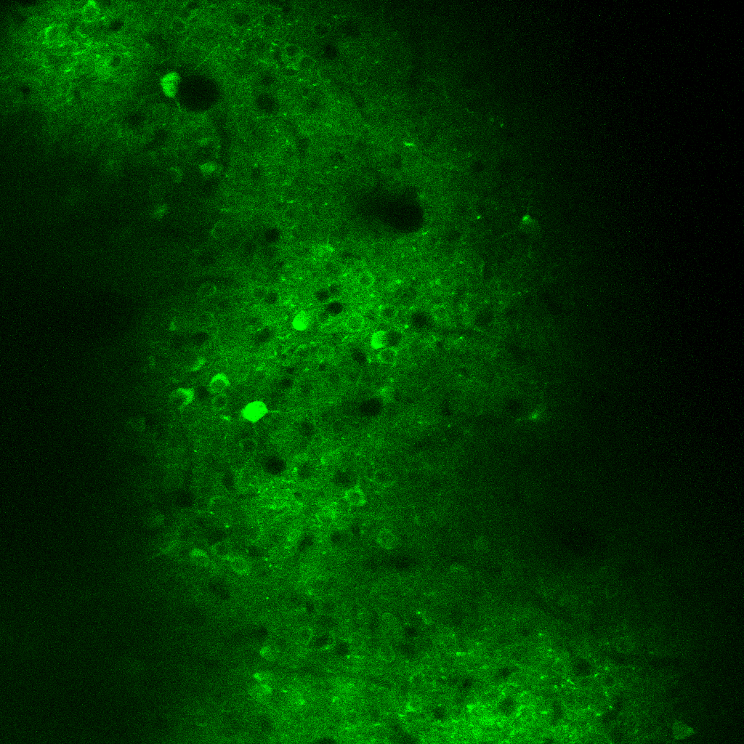
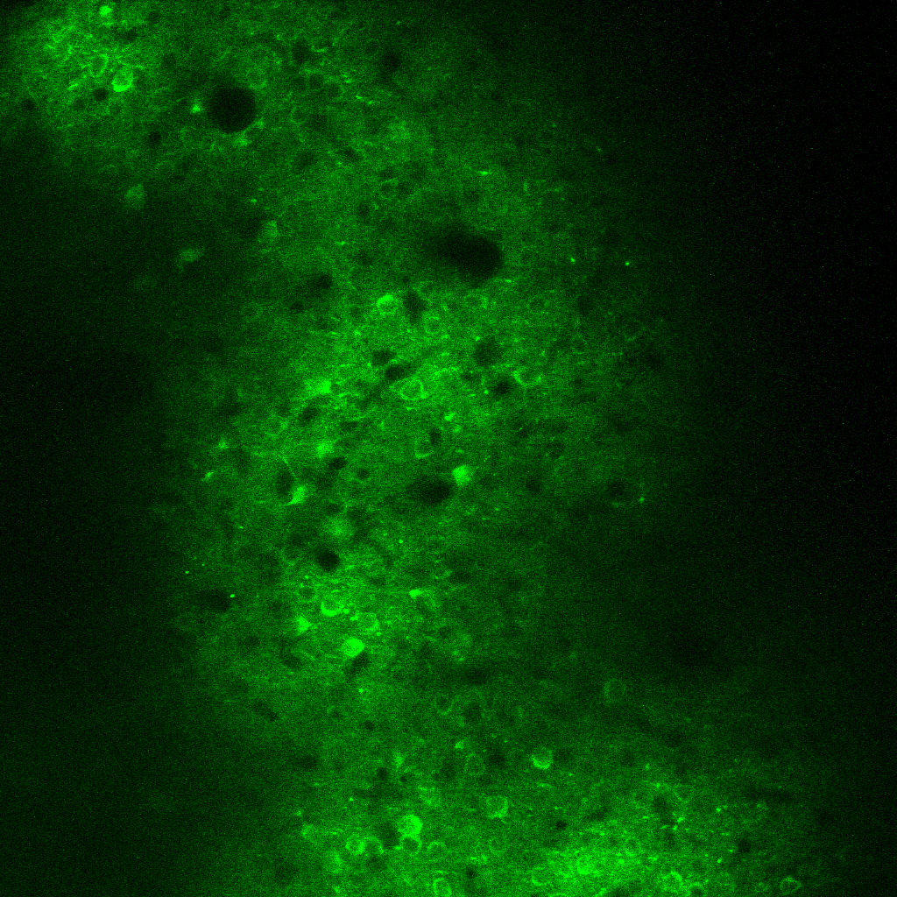
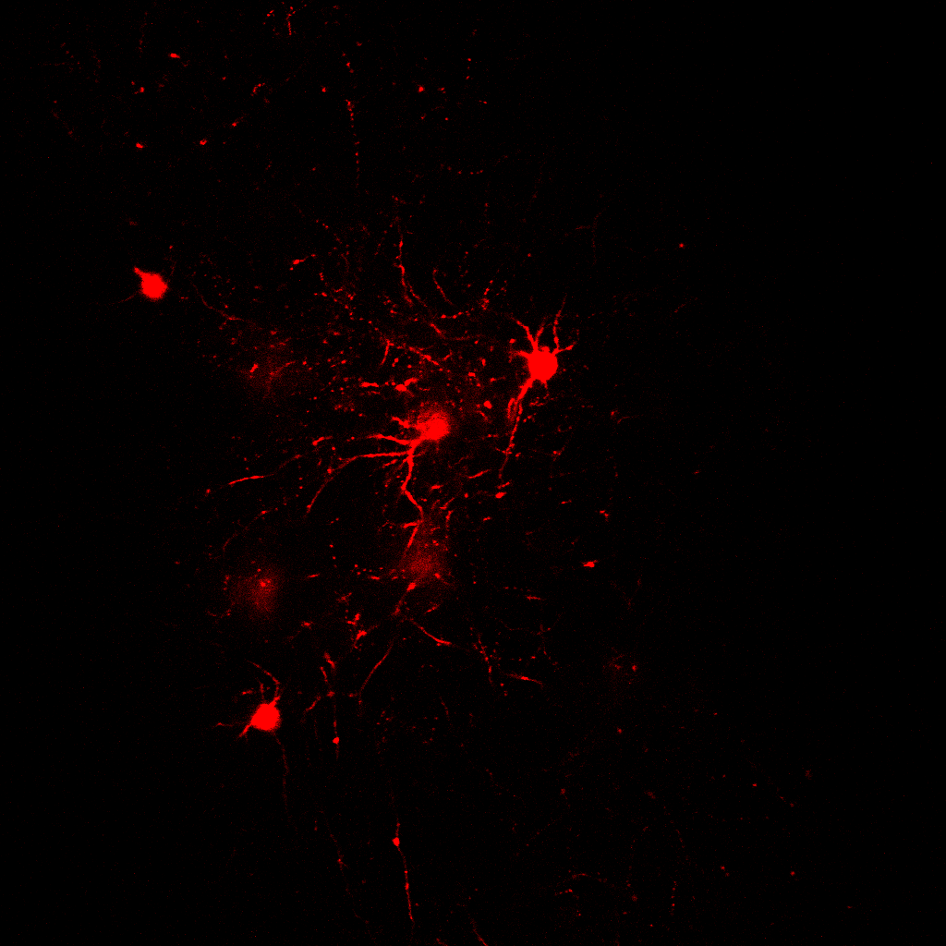
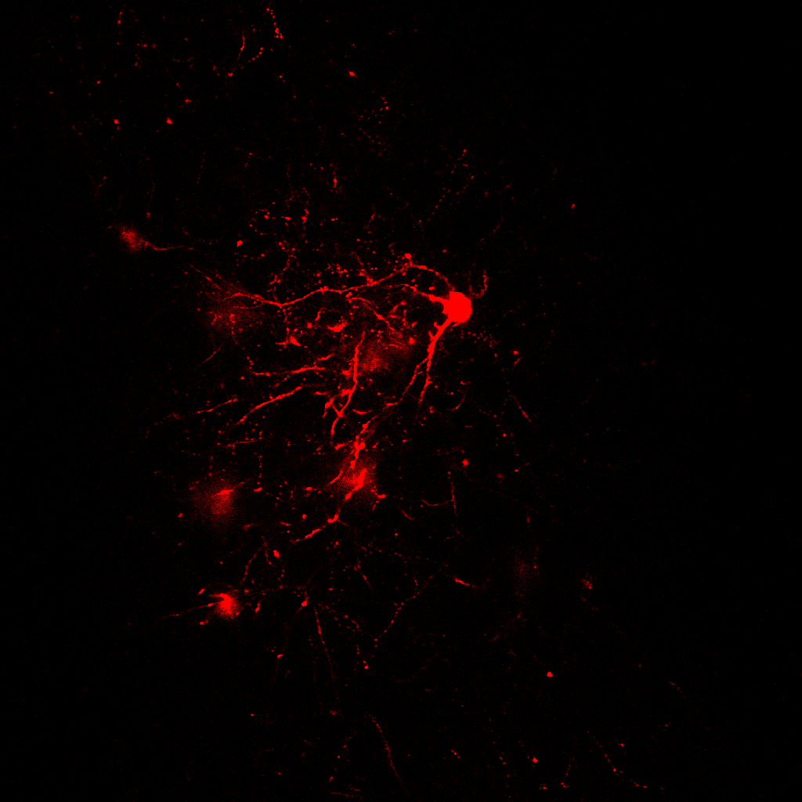
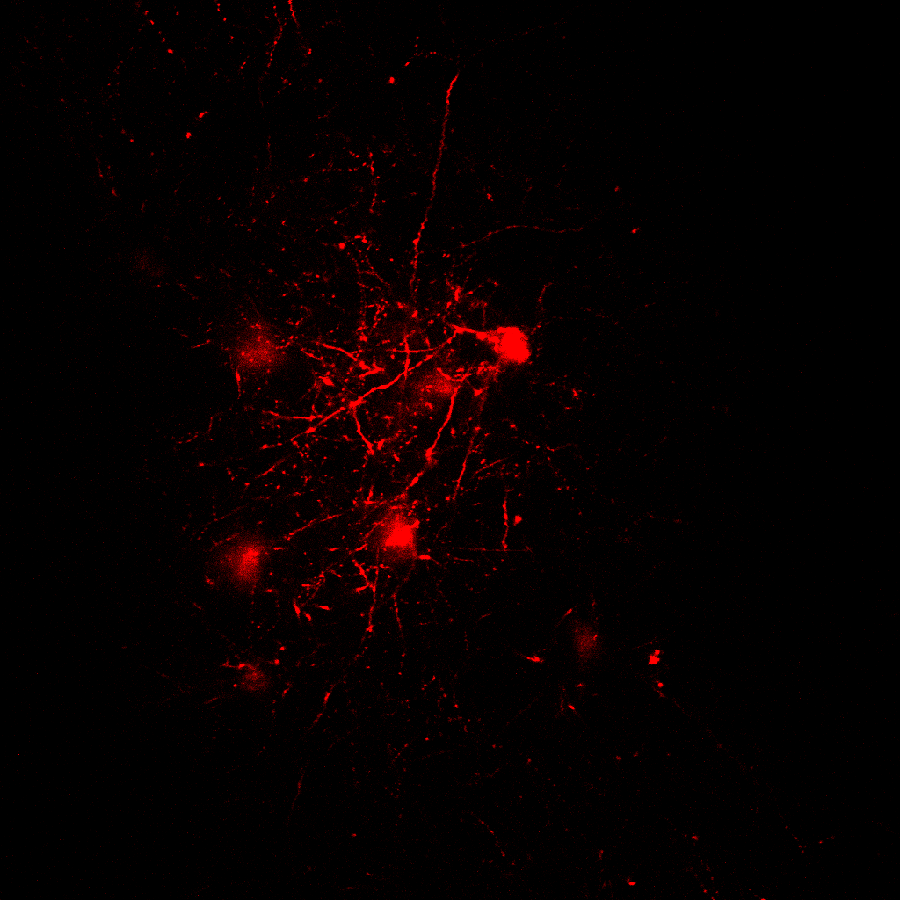
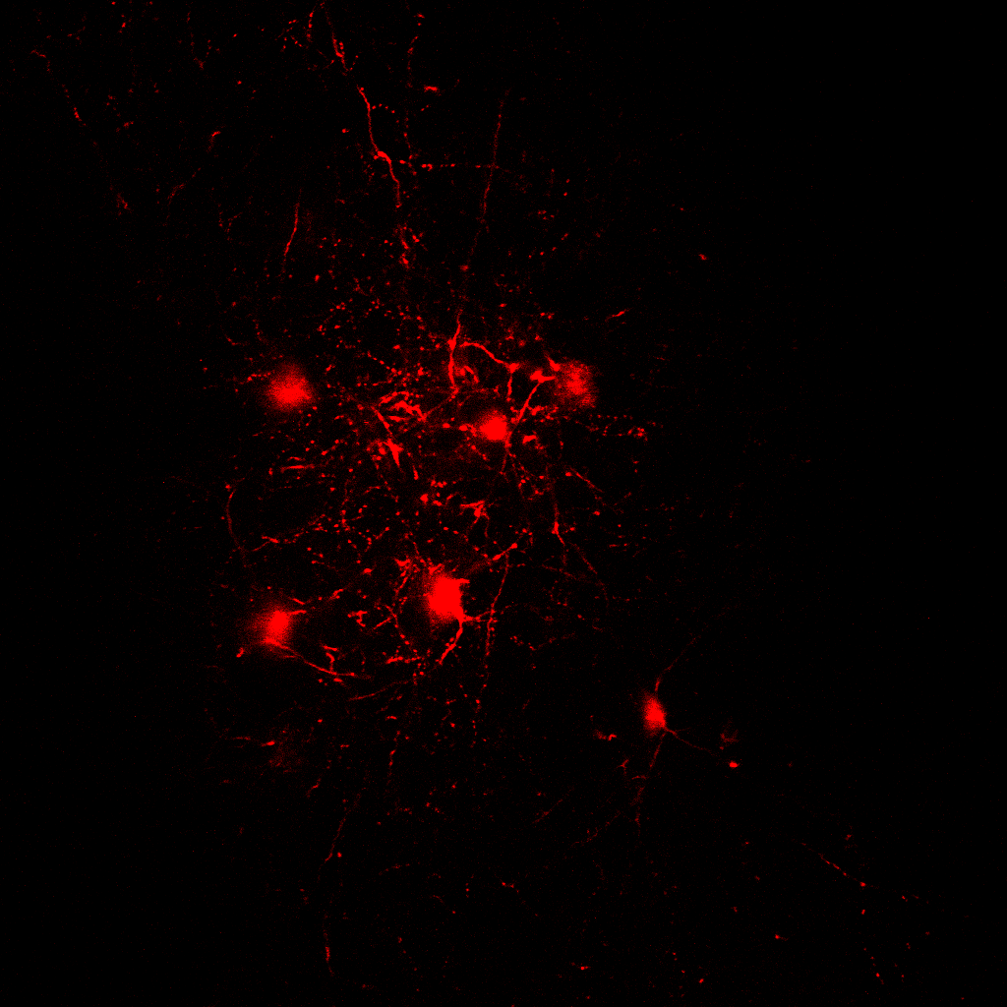
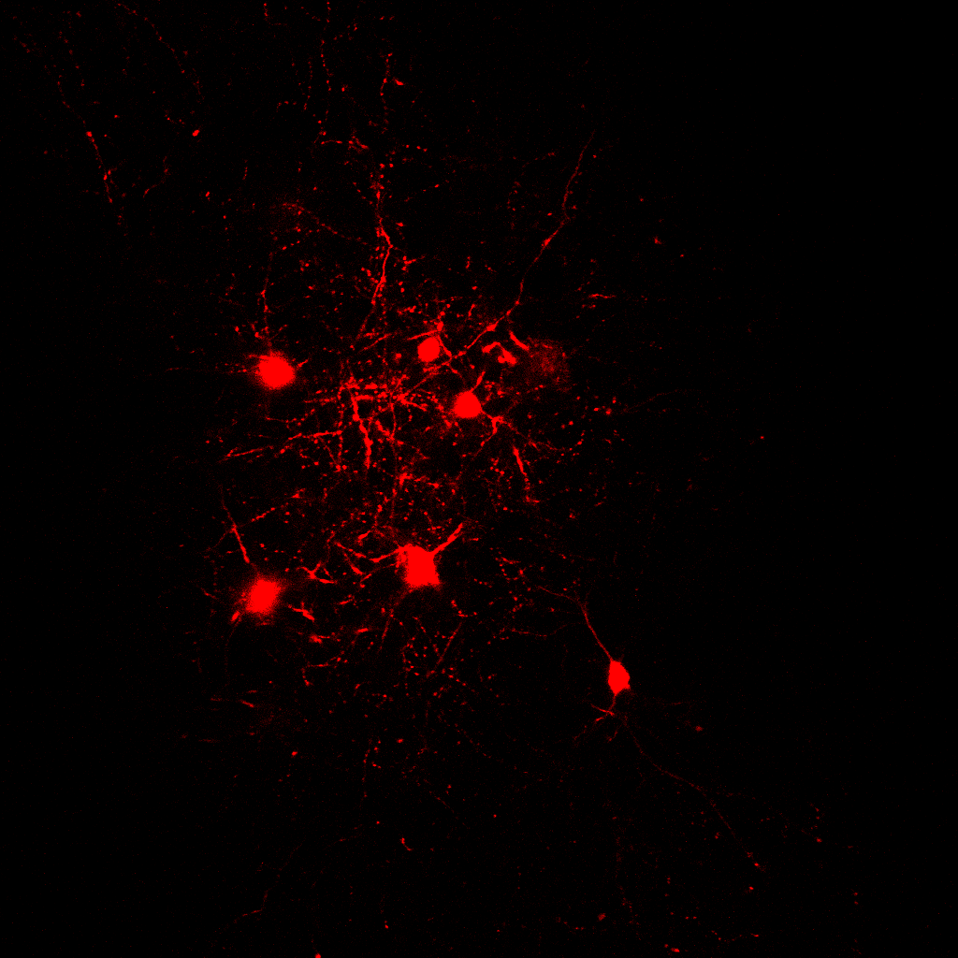
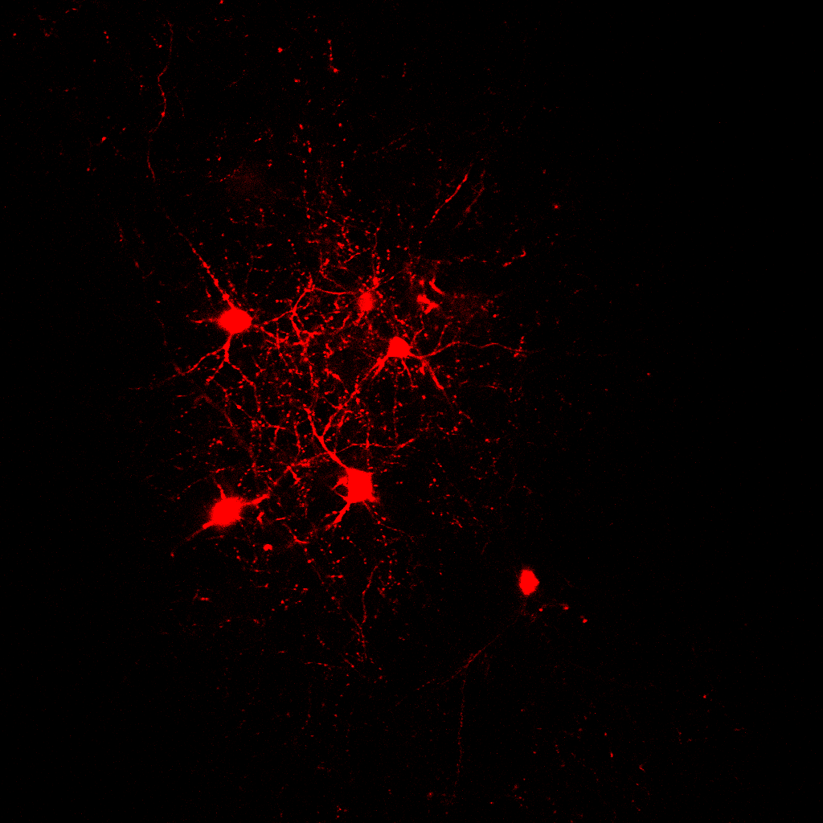
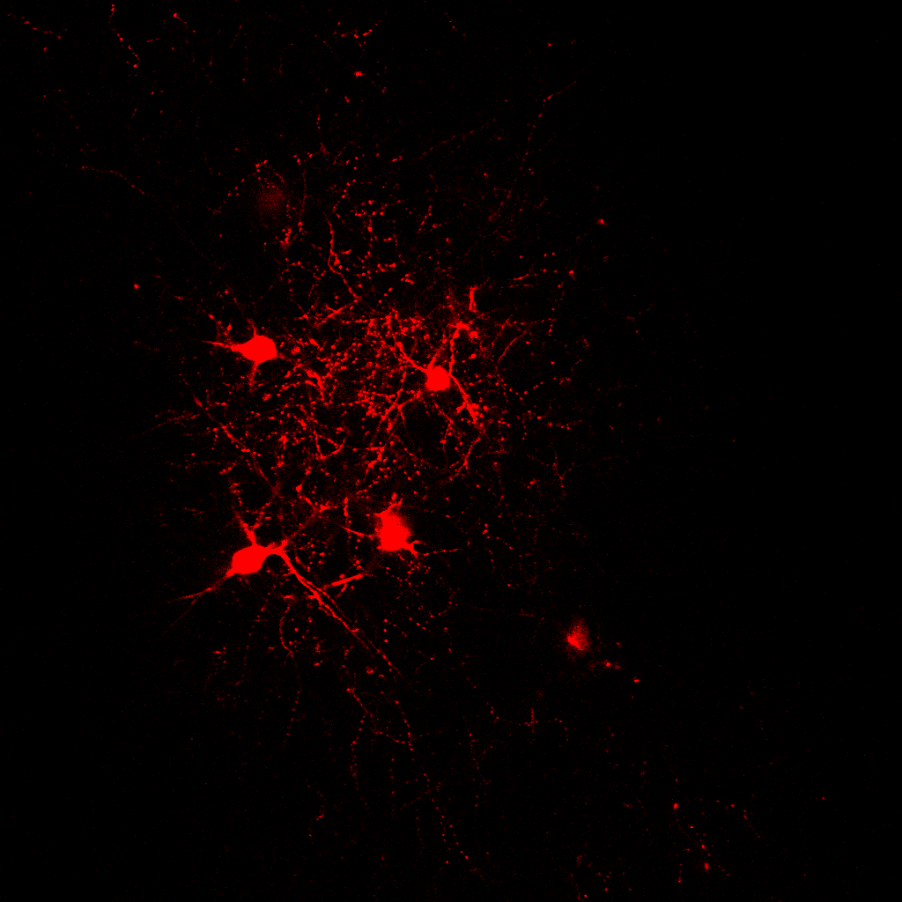
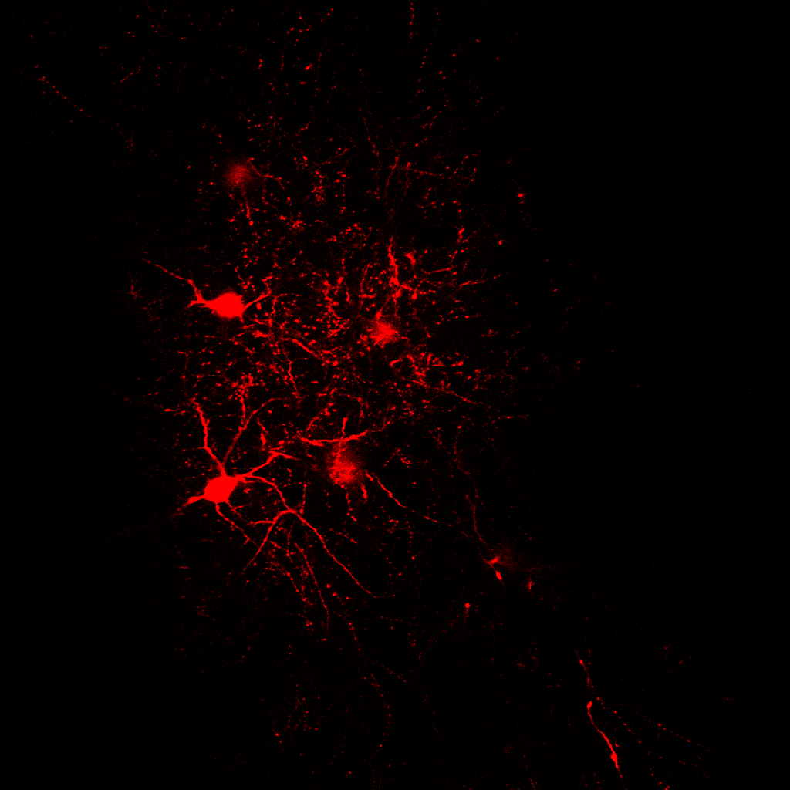
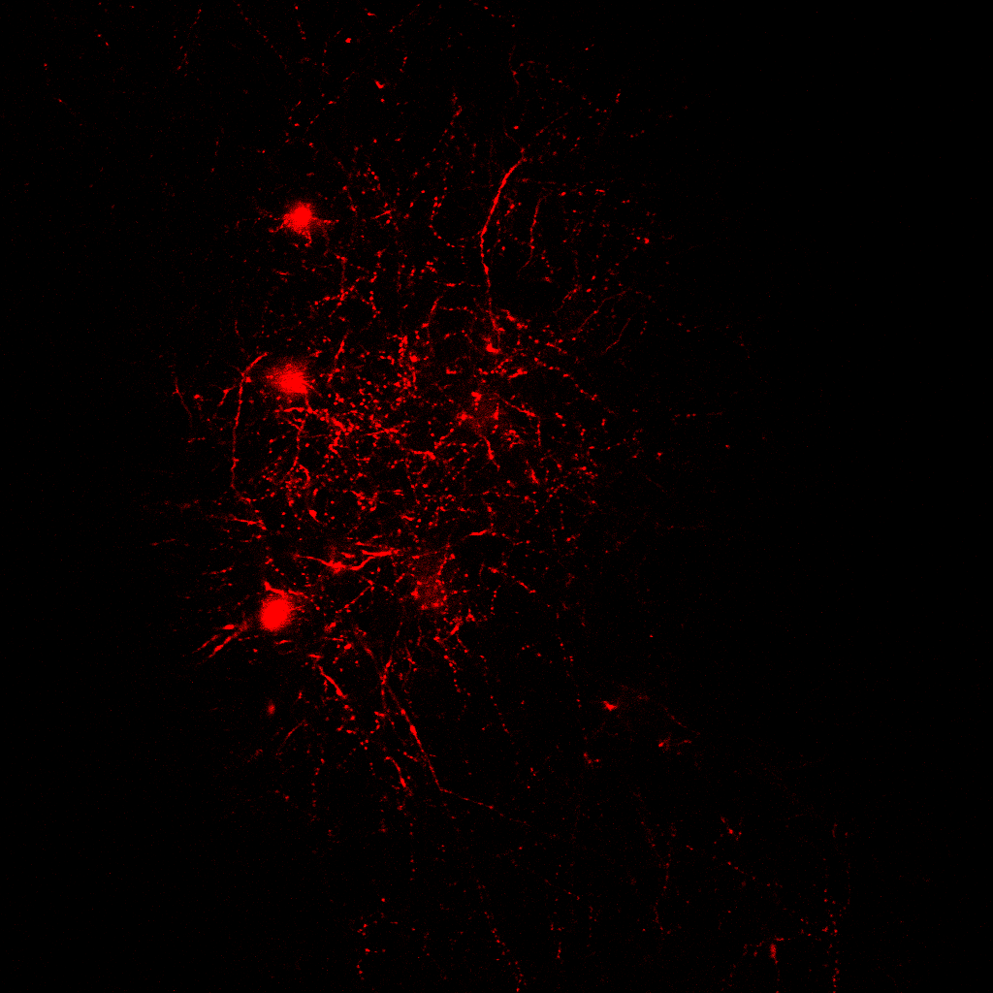
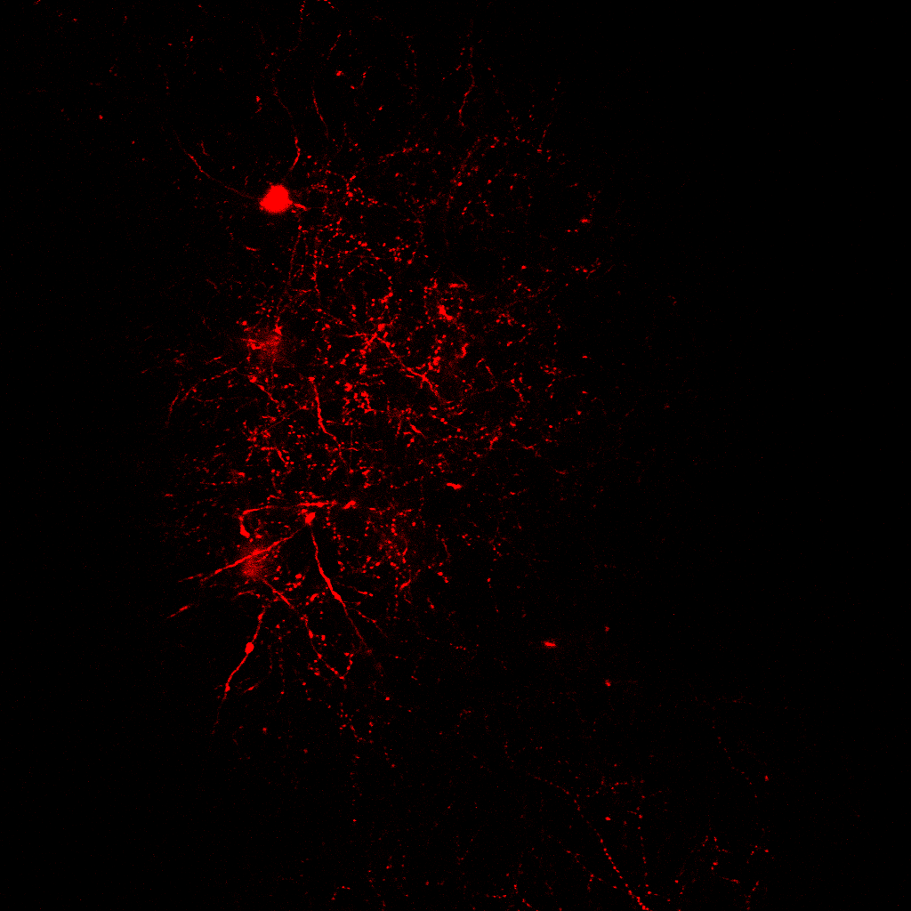
Circuit basis for functional heterogeneity of principal neurons in sensory cortex
057.12
Ana R Inácio, Francisco Pereira, Charles Gerfen and Soohyun Lee
National institute of Mental Health, National Institutes of Health, Bethesda, MD
INTRODUCTION
3 Neuronal activity from S1bf can predict exploratory behavior
z
6 Anatomical organization of presynaptic ensembles
1 Exploratory behavior
4 Correlation of neural activity with behavior is highly stable
2PT Ca⁺⁺ imaging GCaMP6s/f
@ 30Hz
Mice
Emx1-cre + GCaMP6f
CaMKII.GCaMP6s
c
Local field potential
(LFP)
7 Functional properties of presynaptic ensembles
IR imaging
@ 250-500Hz
(whisker motion)
Motion encoder
(locomotion)
d
a
b
LFP
RV-tdTomato
(collapsed Z)
Norm. deltaF/F
Spectrogram of field
Whisking
Whisking
5 Probing presynaptic network of a functionally-identified neuron
RV-tdTomato
(presynaptic ensemble)
FOV 800x800µm
RV-tdTomato⁺/GCaMP6s⁺
presynaptic cells
Locomotion
a
Imaging
Electroporation
Rabies virus
injection
Imaging &
histology
Volume scan
1min
tdTomato
oG
TVA
Alexa594
RV-tdTomato
800 µm
Functional organization of local presynaptic neurons. a) Structural 2PT Ca⁺⁺ imaging: 3D-reconstruction images acquired from 0-800 µm of depth from dura for an example animal. b) Activity of example presynaptic excitatory neurons (tdTomato⁺/GCaMP⁺), in red, versus non-presynaptic local excitatory neurons (tdTomato⁻/GCaMP⁺).
2 Subpopulations of neurons in S1bf encode exploratory behavior
800 µm
a
b
.
.
.
SUMMARY
GCaMP6s/f
(excitatory neurons)
Alexa594
(electroporated neuron)
tdTomato
(starter)
RV-tdTomato
(presynaptic)
b
Day 1
c
Day 3
d
Day 7-10
GCaMP6f cells
(Excitatory) 940nm
Starter (postsynaptic) cell
Presynaptic cells
(tdTomato) 1040nm
DeltaFoF
ACKLOWDGEMENTS
Whisking
30 s
10 s
Stim
Locomotion
Monosynaptic retrograde tracing from a single behaviorally-defined excitatory neuron. a) Experimental outline. b) Electroporation of an example exploratory behavior-predicting neuron. Left: cranial window with a custom-made opening. Middle: 2PT Ca⁺⁺ imaging FOV; arrow denotes the neuron selected for electroporation. Right: neuron filled with Alexa594 upon electroporation. Lower: selected neuron behavioral tuning and (lack of) response to whisker stimulation. c) Neuron expressing tdTomato 3 days after electroporation. d) Volume imaging.
FUNDING

